Slide 1
Message Variables
Structuring and ordering persuasive messages

Slide 2
Does it matter…
If you’re the first person a company interviews for a job… or the last?
If you tell people what conclusion you’d like them to come to… or let them figure it out on their own based on what you’ve said?
Whether you use statistical evidence to support your arguments… or feature narratives from real people?
How many arguments you give someone to buy your product? (Or the number of reasons you should be promoted?)
If you give people only “your side of the story” or if you tell them what they might hear from someone else (like a competitor)?

Slide 3
Today’s lecture
When to use implicit vs. explicit conclusions
Best number of arguments to use
The most effective way to use evidence (& the best types of evidence)
How many times you should repeat a persuasive message
When you should use one-sided vs. two-sided messages
How to determine whether you’ll benefit most from the primacy effect OR the recency effect
How you can use warnings to increase your persuasive effectiveness

Slide 4

Should I tell them what to do?
There is often a choice at the end of an ad or an argument about whether to tell people what to do (explicit conclusion) or to let them “fill in the blank” (implicit conclusion).
Explicit conclusions may work best if:
Receiver is uninvolved.
Receiver is unable to draw own conclusion (i.e. using the peripheral route in ELM).
Implicit conclusions may work best when:
Receivers are highly involved.
Receivers are intelligent enough to draw their own conclusions.
This strategy works best for people who are high in Need for Cognition.

Slide 5
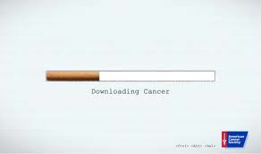

Implicit & Explicit Advertisements

Slide 6

How many arguments do I need?
People who don’t care too much about the topic (low involvement) are unlikely to scrutinize messages-- and are more persuaded by lots of arguments.
The number of arguments acts peripheral cue. It’s not the content that counts, just the mere number.
People who are highly involved with the topic are more persuaded by fewer but higher quality arguments.

Slide 7
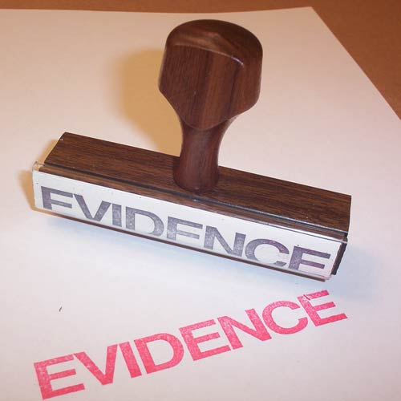
Use of Evidence
To be effective in persuading people, the evidence you use must be new to the audience.
Evidence should be “good” evidence:
Source of evidence must be credible
Evidence must be relevant to the claim
High credibility persuaders have less need to rely on evidence.
If source credibility is low/moderate, effective use of evidence is more critical.
Are statistics more effective as evidence or is it better to use narratives as evidence?

Slide 8
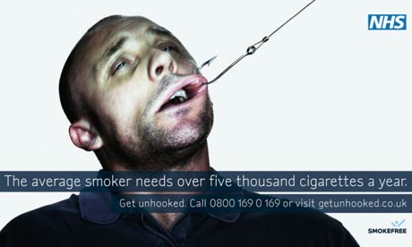
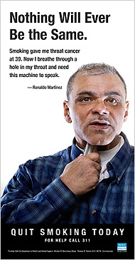
Type of Evidence: Statistical vs. Testimonial (Smoking)

Slide 9

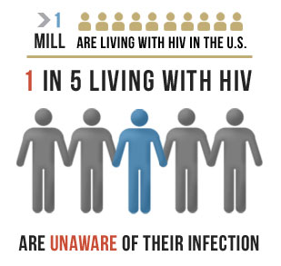
Statistics vs. Testimonial (HIV/AIDS)

Slide 10

How many times should I tell them?
Repetition can be good or bad.
Mere exposure theory says people will respond better to familiar stimuli.
Ex: voting behavior and name recognition
However, too much repetition may become tedious and lead to rejection of the message.
Three times seems to work well!

Slide 11
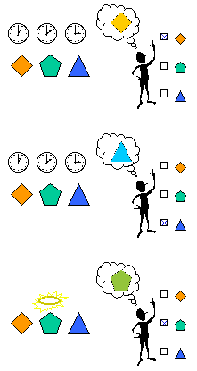
Should I be the first to present my case or the second?
Primacy Effect: The first speaker is more persuasive.
Most effective with back-to-back messages.
If some time passes before a decision is made, this also enhances the primacy effect.
The primacy effect is also in effect when people are high in involvement (assuming that both sets of arguments are equally strong)

Slide 12
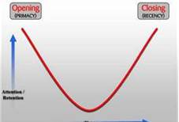
Recency Effect
Recency Effect: The last speaker is more persuasive.
Most effective when you hear the first message, but there is a delay before you hear the second, which is followed immediately by a decision.
Recency effect is also most likely to occur when the audience is low in involvement.

Slide 13
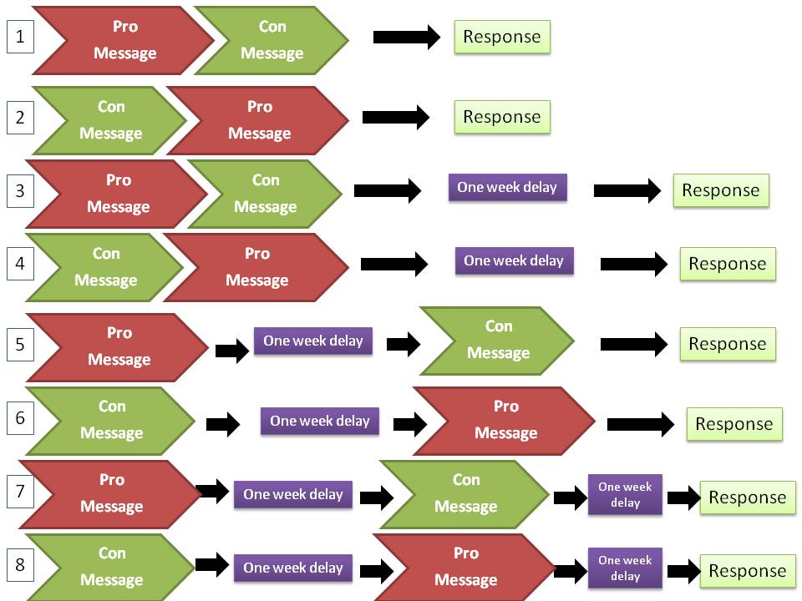
A more nuanced view
No difference between #1 and #2 or between #7 and #8.
Strong primacy effect for #3 and #4.
Strong recency effect for # 5 and #6.

Slide 14
If you’re interviewing for a job (or competing for a client)
The advantage of speaking first versus last depends on:
Whether there is a delay between presentations
Whether there is a delay between the presentations and the decision-making process.
So…find out their schedule:
If there’s a delay between when you and your competition will talk to the decision makers but there is NO delay after the last presentation and the decision, you should speak LAST.
If you and your competitors will make your case consecutively (one right after the other), and there IS a delay after the last presentation and the decision, you should speak FIRST.
Or, more simply, if there’s a delay between all of the presentations/interviews and the decision, speak first. You might win, and you won’t lose. But if a decision will be made immediately after the last presentation, go last.
Who are you going to be talking to? If you’re being interviewed by the person you’re directly reporting to (or talking to a high-involvement audience), speak first.
Remember, ordering effects are no substitute for simply being the best.

Slide 15

Should I tell them what the other side will say?
Message sidedness refers to the number of positions being presented in a message.
One-sided messages may simply ignore opposing arguments.
The goal is to convince people that a problem exists and present a solution.
Two-sided messages present arguments from both points of view.
A “refutational two-sided message” is the most effective.
It presents the “other side” of the argument but concludes that the persuader’s view is more desirable.

Slide 16
One-sided messages are more effective when:
The audience is in general agreement with the position advocated.
The desired outcome is to reinforce existing attitudes or increase the commitment of the audience.
The audience is not likely to encounter messages that contradict the position being advocated.

Slide 17


Slide 18
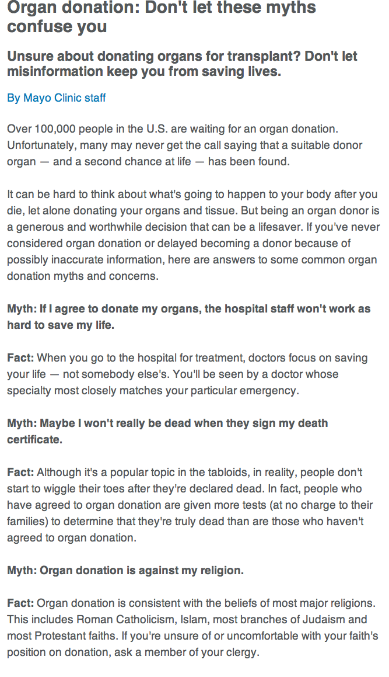

Slide 19

Who responds best to two-sided (refutational) messages?
People with more formal education (at least a high school degree).
People who will be exposed to opposing arguments in the future.
People who already have been exposed to opposing arguments.
Before accepting persuader’s opinion, opposing arguments must be refuted or shown to be unimportant.
Failure to acknowledge opposing arguments may raise questions of source competence or trustworthiness.

Slide 20

Message sidedness and Truisms
What’s a cultural truism?
Effect on cultural truisms
Refutational treatments most effective
Effect on non-truisms
Supportive and refutational treatments were about equal in effect

Slide 21

How can I get people to resist being persuaded by the other side?
Inoculation theory uses a biological metaphor:
Give people a weakened “dose” of what the other side will say.
Cannot provide “full strength” argument.
Like a vaccination, this creates resistance.
Supportive strategy
Provide people with reasons to continue believing what they already do.
The greatest resistance is seen when both strategies are used together AND there is a bit of a time delay so people can form their own counterarguments.

Slide 22
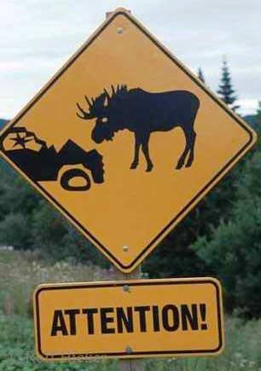
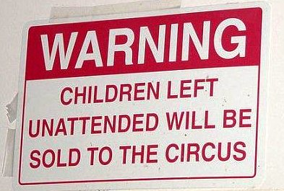
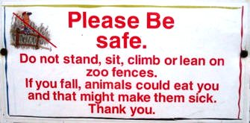
Warnings
Forewarning people they are going to be persuaded will also make them more resistant.
There are two types of forewarnings:
Persuasive intent
Specific topic and position
Forewarnings that an audience’s attitudes will be attacked seem to irritate and even anger people, which helps resistance further.

Slide 23
Who should you vote for on November 6th?
www.isidewith.com (“I side with”…)
You answer a series of questions about WHAT is important to you and the DEGREE of importance the issue is to you and they tell you how you line up with the candidates.
The evidence of the candidates’ stances on each issue (and their consistency) isn’t provided, but should be accessible via internet searches.
Just beware of less-than-credible sources. Double check claims about “the other guy” on:
www.factcheck.ORG
www.snopes.com

Slide 24
Decay of Message Effects
Your goal is to deliver message as close to action point as possible.
Influences on the amount of decay over time:
The number of supporting points for your position
The communicator’s credibility
The receiver’s level of involvement in issue
High involvement = less decay of message effects

